Slide 1
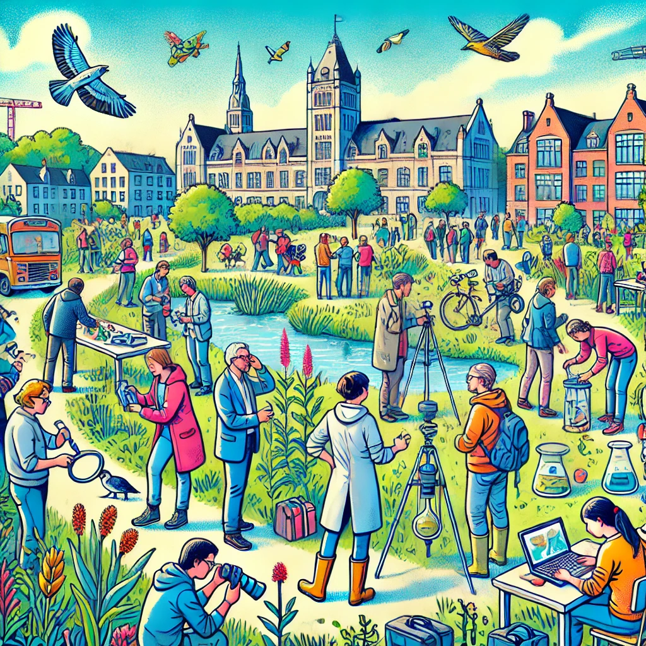
Community Building for Citizen Science
Practical Workshop for Scientists, Policy Makers, and Citizen Science Practitioners
    Date: September 26th
    Bram Kreuger – University library VU Amsterdam
    B.a.kreuger@vu.nl
    Wetenschap in de wolken

Slide 2
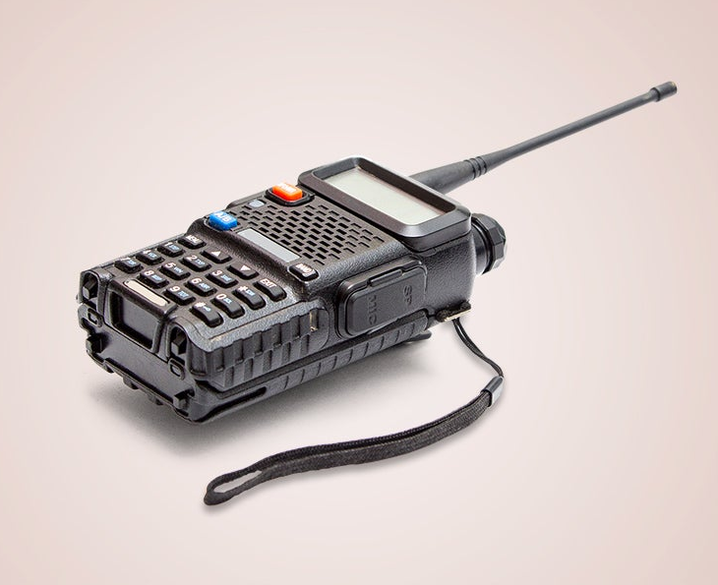
Introduction
Growing trend in Europe linked to the European Open Science programme.
This workshop is based on SCIVIL Communication in citizen science.¹
Citizen Science can:
Democratise Science
Bridge the gap between society and science
Increase your data collection and research output
Give you new insights
It does require hard work and dedication to build trust in your community. This training will get you started with that.

Slide 3
About this event
The workshop lasts around an hour
Afterwards Sem Barendse from Wetenschap in Dialoog will host a short discussion on Science communication
There will be plenty of time for questions and discussion!

Slide 4
Workshop goals
Learn about community building for Citizen science (CS)
Take a research question or project idea and create a solid communication plan
Share practical tips and strategies
Learn how KennisCloud can be used for your CS project

Slide 5
How does this workshop work?
Depending on the number of participants. Form four teams.
Each team chooses a case study (of their own, or from me)
I will explain the principal components of the plan
This is usually supported by an example from experience or literature
There will be a small exercise per component
Which culminates in a short pitch, by you!
Any questions before we get started?
Notes:
Vier case studies bedenken

Slide 6
Which research domain are you active?
Behavioural Sciences & wellbeing
Archaeology, history and heritage
Climate & environment
Biodiversity & Biology

Slide 7
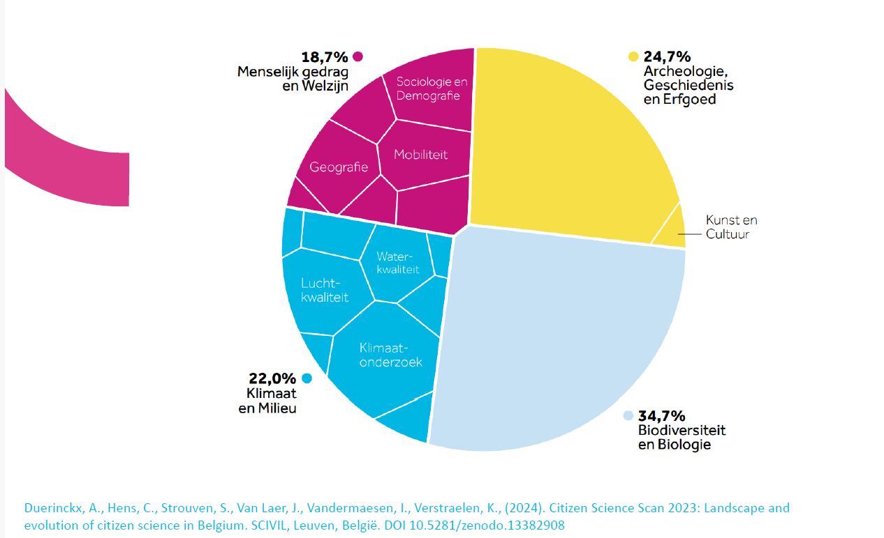

Slide 8
Example research questions
Archaeology: Where are surface artifacts found in a specific region, and how do they relate to ancient settlement sites there?
Biology: How is the population of a particular species changing over time in different habitats within a certain area?
Social Sciences: How do people in various neighbourhoods of a city perceive their safety, and what factors affect these perceptions?
Environmental Sciences: How does air pollution vary in different parts of an urban area throughout the day, and how is it connected to traffic levels and weather conditions?

Slide 9
Citizen Science:
“95% is communication”

Slide 10
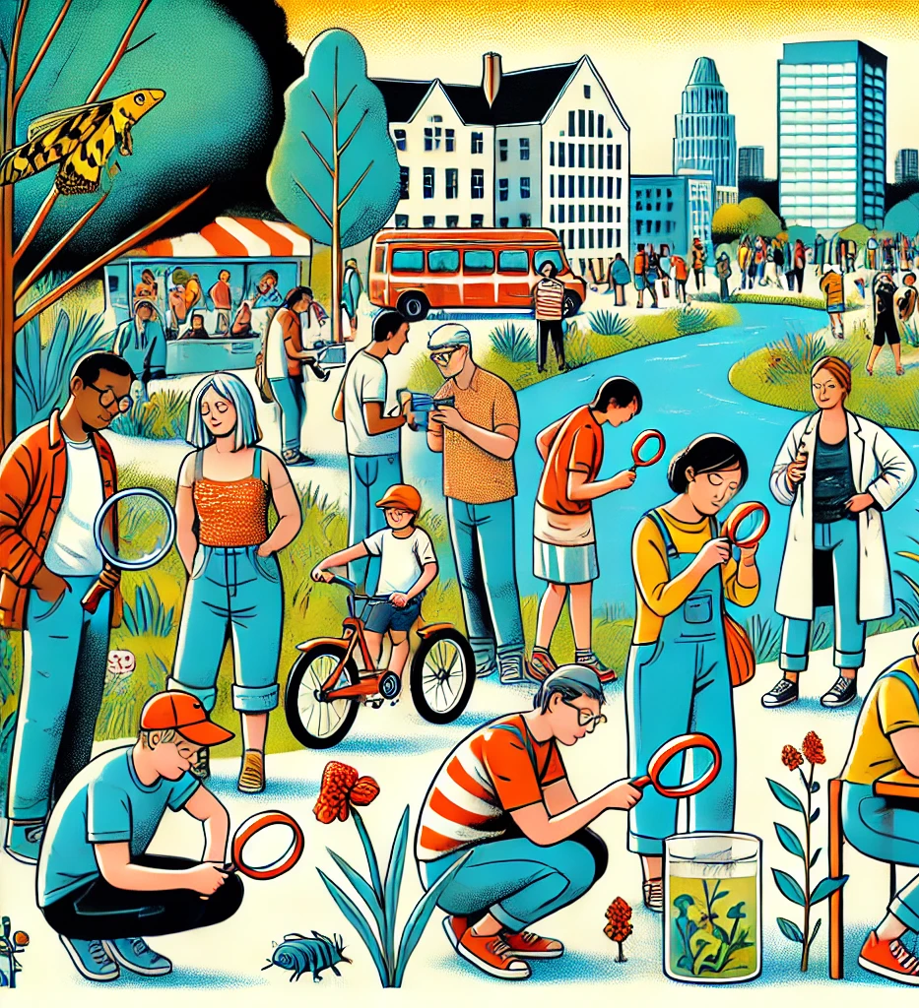
Setting Project Objectives
Why define objectives?
Guide your communication strategies
Align with audience needs
Exercise: Define Objectives
Each group selects a project and sets specific objectives
Contribution to science
Education
Engagement of citizens as stakeholders
Ex: “By transcribing historical documents. Citizens will contribute to science and learn transcribing methods”

Slide 11
Determining Engagement Levels
Type | Description
Crowdsourcing | Members of the public offer their time and devices only.
Distributed intelligence | Members of the public sift through gathered research material and provide simple interpretations or help categorise the material.
Participatory science | Volunteers are engaged at the start of the project. They help define the problem, collect data and then help the scientists analyse the material. However, the researcher/expert has a high level of control over the analysis and interpretation.
Extreme citizen science | Researchers and volunteers develop the various steps in the research process together. But here the role of the scientist is confined to that of facilitator. The volunteers run the citizen science project and do the work.
Determine how citizens will participate
Exercise: Choose Engagement Level
Groups choose the appropriate engagement level for their project
Justify the choice based on objectives and resources
We focus on “Contributory projects” Which are run top down. There are also collaborative and co-created projects

Slide 12
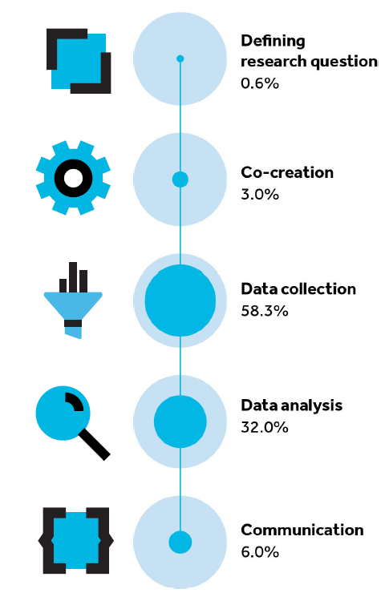
Determining Engagement Levels

Slide 13
Identifying and Understanding Your Audience
Audience Segmentation
Primary: Most likely to participate
Secondary: Interested but not participating
Intermediary: Can help to communicate on your behalf
Exercise: Define Audience
Create demographic and psychographic profiles for target audiences

Slide 14
Investigating Audience Motivations
Type | Description
Collective motivation | The citizen scientist sees the project aims as important.
Norm-related motivation | The participant hopes for positive responses from friends, family or workmates
Motivation based on reward / extrinsic motivation | Participation brings real benefits, such as building a reputation or making new friends.
Collective identification | The participant identifies with the group, its norms and its values.
Intrinsic motivation | Participation in the project gives pleasure.
Why People Participate
Exercise: Explore Motivations
Groups brainstorm potential motivations for their target audiences
Discuss how these motivations can be leveraged
These will be assumptions and should be validated

Slide 15
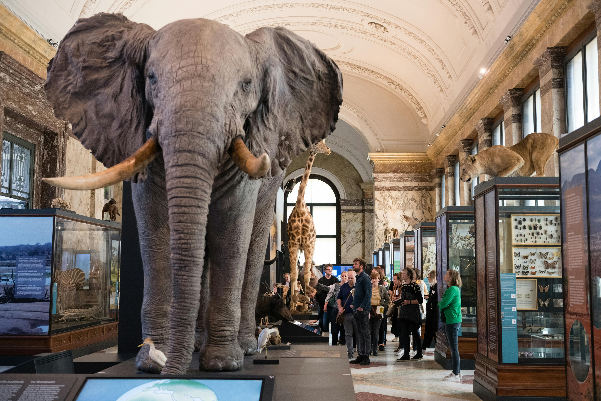

Investigating Audience Motivations
Transcribing historical religious documents
Hollandse Luchten: measuring air quality in region around the north sea channel
Afrika museum Tervuren Belgium

Slide 16
Engage and evaluate
To evaluate the success of the project we should create a clear evaluation framework to measure our engagement strategy. This should consist of:
Clear indicators – Both quantitative and qualitative
Involve stakeholders
Timing – Before / During / After
(ideas for) Indicators to measure:
    Communication: Number of workshops, social media posts, etc.
    Engagement: Access to information, participant satisfaction, empowerment, etc.
    Research output: Observations, letters transcribed, research questions proposed, etc.
Exercise: Create an evaluation framework
What should be measured when and who should be involved

Slide 17
Engage and evaluate
The FloodCitiSense project uses a pluviometer and an app to keep residents in Brussels, Rotterdam, and Birmingham informed about rainfall and flood risks.
Citizens build their own pluviometer and install it in their gardens.
An evaluation framework by Kieslinger et al. measures the project's impact on:
Science: Number of scientific publications.
Citizen scientists: Contributions, knowledge, and skill gains.
Socio-ecological impact: Innovation in technology and influence on city water and flood management policies.

Slide 18
Tactics and tools - I
Initial participation
Personal interest
Contributing to science
Fun Factor
Desire to learn
Continued participation
Validation and appreciation for the contribution
Deeper understanding of the topic
Contact with the scientist or other community members
Willingness to assume tasks or roles in the project
Generic versus specific approach
Generic
Publicly publish your project to look for participants.
Social media, flyers, press, posters, etc
Specific
Personal invitations
Contact people on member lists
Collaborate with organisations
Initial or continued participation
The initial drop-out rate of CS participation is highest at the initial participation or right after.
Main reasons to drop out here are: Too much jargon. Non-user friendly apps. Afterwards its: Lack of recognition or lack of openness.

Slide 19
Tactics and tools - II
Tactic | Generic or Specific | Initial or continued | Outcome
Hitch a ride on existing network | Specific | Greatest effect initially. You find people with a shared interest. Though collaboration can be good for continuation | Build and grow your community
Offer a fun experience | Specific | This tactic can be employed throughout. It builds the community by getting to know each other and having a good time | Give participants an enjoyable experience
Use social media | Both | Social media can be used to attract new participants and maintain contact with your current participants | Continually interact with the audience
(Digital) story telling | Both | Continuous. When your story is about your participants they are recognised for their contribution and you satisfy the social motivations. | Personal stories can create a sense of loyalty among citizen scientists.
Gamification | Both | Integrating game-design elements in your project works best in support of continued participation. | Experience and engagement: an extra fun-factor for the project.
Find project Ambassadors | Both | Continuous. Enthusiastic volunteers can be highly intrinsically motivated to play a role in your project. | Project ambassadors can be role models for other participants and be of help in promotion and community building.

Slide 20
Tactics and tools - III
Exercise:
Pick and choose multiple tools that could work for your project. Describe in a few sentences per tool how you would use this tool. There are more tools available then mentioned in the last slide. Also think of the outcomes of using the tool.
Example:
“Fun experience: We will organise an event in a local church in Amsterdam. Here participants will learn how to transcribe letters and get a tour of the church. Outcome: We work on community building while having a fun experience and the participants will become better at transcribing”

Slide 21
Pitch time!
Give a short pitch in about 5 minutes about your citizen science project the accompanying plan to build a community around it!
Notes:
Neem 5 minuten om het voor te bereiden…

Slide 22
Tips and tricks
Be Clear
    Avoid oversimplifying or overcomplicating science communication.
    Convey the hard work behind scientific efforts understandably.
Uniformity
    Use consistent project names, logos, and hashtags.
    Ensure uniform style and terminology.
Inclusive Communication
    Involve the whole team in communication efforts.
    Keep everyone updated on project developments to maintain consistency.
    Integrate community engagement into your schedule. Meetings, social media posts, competitions, etc.
Topical Relevance
    Relate project communication to current events.
    Highlight the relevance of the project to ongoing news.
  Use KennisCloud

Slide 23
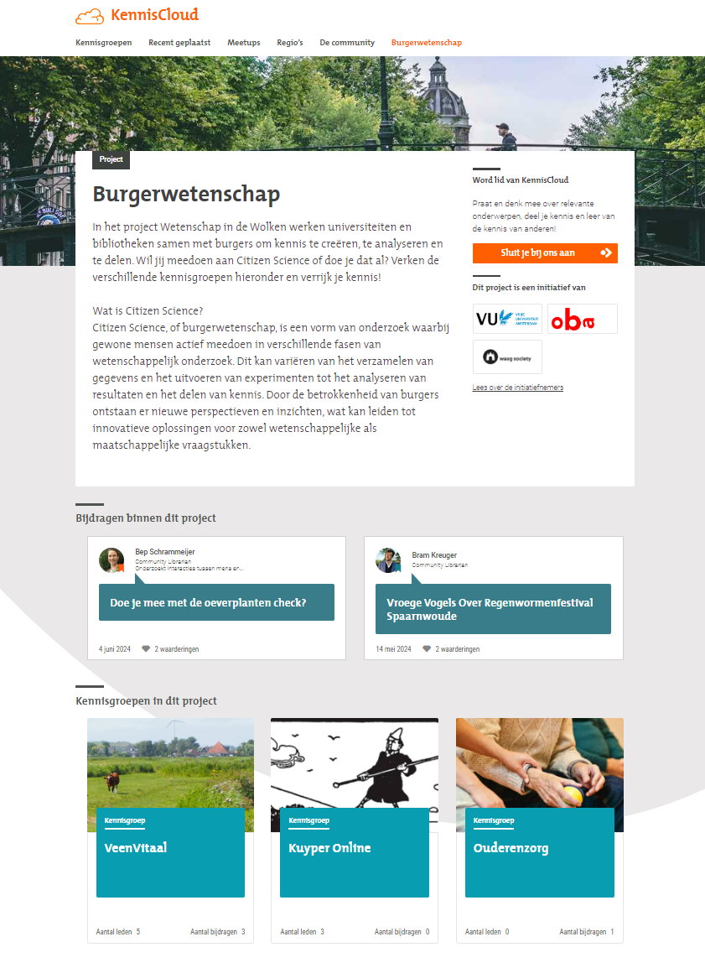
KennisCloud
www.kenniscloud.nl
Using a platform for two-way communication is essential to any CS project
This ensures participants feel heard and it empowers them
There are possibilities to share sources, literature and discuss research
There are possibilities for meetups
Ensuring both online and offline communication
Added functionalities for your CS project

Slide 24
Workshop goals
Learn about community building for Citizen science (CS)
Take a research question or project idea and co-create a solid plan
Share practical tips and strategies
Learn how KennisCloud can be used for your CS project

Slide 25
Community Building for Citizen Science
Practical Workshop for Scientists, Policy Makers, and Citizen Science Practitioners
    Date: 26th September 2024
    Bram Kreuger – University library VU Amsterdam
    B.a.kreuger@vu.nl
    Wetenschap in de wolken

